Slide 1
Node.JS
Lecture 3
Introduction & its modules

Slide 2
Road Map
How Mean Stack works?
Introduction to Node.JS
Concurrency
Event Loop/Event Emitter
Non Blocking I/O
Performance
Node.JS Modules
NPM
Installation
Getting Started

Slide 3



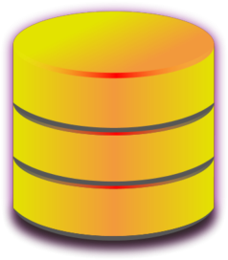
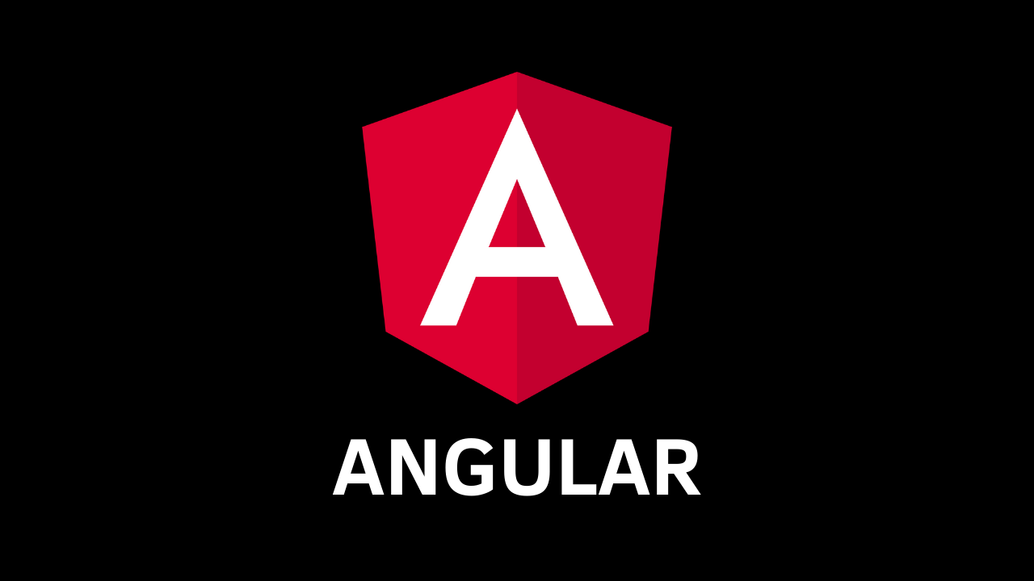


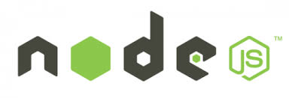
JSON
JSON
JSON
JSON
Collection of JavaScript based technologies used to develop web applications.

Slide 4
What is NodeJS?
A JavaScript runtime environment running Google Chrome’s V8 engine
a.k.a. a server-side solution of JS
Compiles JS, making it really fast
Runs over the command line
Designed for high concurrency
Without threads or new processes
Never blocks, not even for I/O
Uses the CommonJS framework
Making it a little closer to a real OO language

Slide 5
Concurrency: The Event Loop
Node.JS is single threaded.
But it can support concurrency via the concept of event and callbacks.
Instead of threads Node uses an event loop with a stack
Alleviates overhead of context switching.
Node uses observer pattern.
Node thread keeps an event loop and whenever a task gets completed, it fires the corresponding event which signals the event-listener function to execute.

Slide 6
Event Loop
Every API of Node.js is asynchronous and being single-threaded
JavaScript engine maintains several queues of unhandled tasks.
These queues include things such as events, timers, intervals, and immediates.
Each execution of the event loop, known as a cycle, causes one or more tasks to be dequeued and executed.

Slide 7
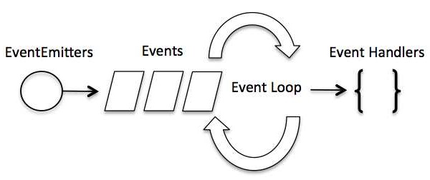
Event Handling

Slide 8
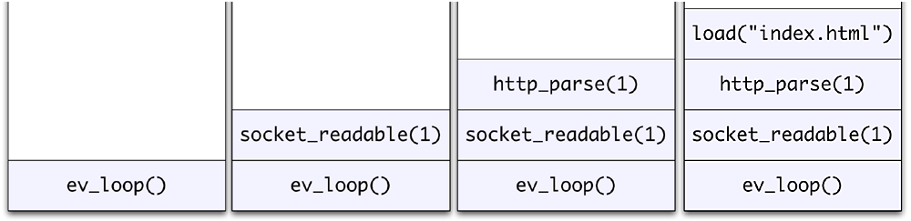
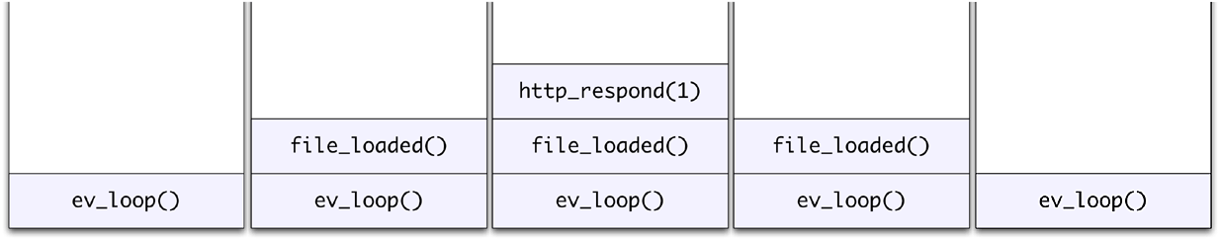
Event Loop Example
Request for “index.html” comes in
Stack unwinds and ev_loop goes to sleep
File loads from disk and is sent to the client

Slide 9
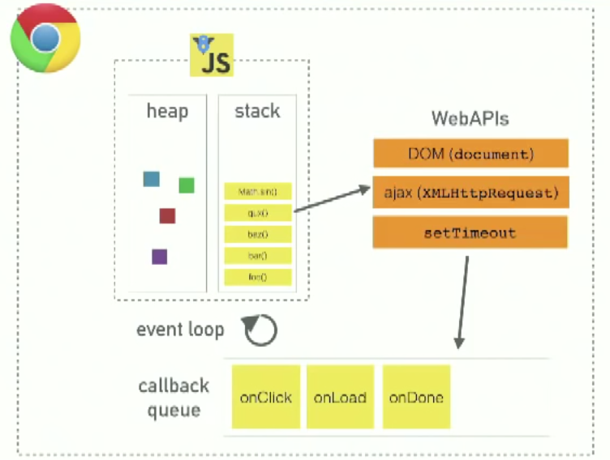
Event Loop

Slide 10
Event Loop
As these tasks execute, they can add more tasks to the internal queues.
They use async function calls to maintain concurrency. Node uses observer pattern.
Node thread keeps an event loop and whenever a task gets completed, it fires the corresponding event(Event Emit) which signals the event-listener function to execute.

Slide 11
Event Emitter
Many objects in a Node emit events.
For example, a Server emits an event each time a peer connects to it, an fs.readStream emits an event when the file is opened.
In the browser, an event could be a mouse click or key press.
All objects which emit events are the instances of events.EventEmitter.
Elsewhere in the code, subscribers can listen for these events and react to them when they occur.

Slide 12
Event Listening
To set up an event listener in Node, use the on(), addListener(), and once() methods.
The on() and addListener() work in exactly the same manner: they create listeners for a specific type of event.
We prefer on() over addListener() as it requires less characters.
Once() only invoke call back function one time and stop the listener.
Error events can be handled like any other events. Following code shows how an error event is handled using on():

Slide 13
Example
var http = require("http");
http.createServer(function (request, response) {
response.writeHead(200, {'Content-Type': 'text/plain'});
response.end('Hello World\n');
}).listen(8081);
console.log('Server running at http://127.0.0.1:8081/’);
Here “listen” is a wrapper function of on() event listener

Slide 14
Threads VS Event-driven
Threads | Asynchronous Event-driven
Lock application / request with listener-workers threads | only one thread, which repeatedly fetches an event
Using incoming-request model | Using queue and then processes it
multithreaded server might block the request which might involve multiple events | manually saves state and then goes on to process the next event
Using context switching | no contention and no context switches
Using multithreading environments where listener and workers threads are used frequently to take an incoming-request lock | Using asynchronous I/O facilities (callbacks, not poll/select) environments

Slide 15
Cost of I/O

Slide 16
Non-blocking I/O
Servers do nothing but I/O
Scripts waiting on I/O requests degrades performance
To avoid blocking, Node makes use of the event driven nature of JS by attaching callbacks to I/O requests
Scripts waiting on I/O waste no space because they get popped off the stack when their non-I/O related code finishes executing

Slide 17
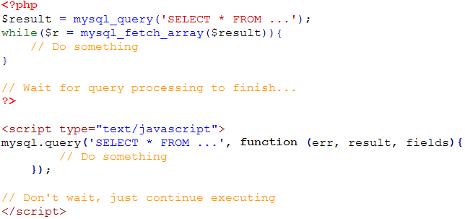
I/O Example

Slide 18
Consistency
Use of JS on both the client and server-side should remove need to “context switch”
Client-side JS makes heavy use of the DOM, no access to files/databases
Server-side JS deals mostly in files/databases, no DOM

Slide 19
Performance Node.js VS Apache
It's fast.(As soon as Node starts its server, it simply initiates its variables, declares functions and then simply waits for the event to occur.)
It can handle tons of concurrent requests
It's written in JavaScript (which means you can use the same code server side and client side)
Platform | Number of request per second
PHP ( via Apache) | 3187,27
Static ( via Apache ) | 2966,51
Node.js | 5569,30

Slide 20
Node. JS
Introduction to its modules

Slide 21
Node.JS major Components

Slide 22
Node Modules
Import using require()
System module: require("fs"); // Looks in node_module directories
From a file: require("./XXX.js"); // Reads specified file
From a directory: require("./myModule"); // Reads myModule/index.js
Module files have a private scope
Can declare variables that would be global in the browser
Require returns what is assigned to module.exports
var notGlobal;
function func1() {}
function func2() {}
module.exports = {func1: func1, func2: func2};

Slide 23
Node Modules
Many standard Node modules
File system, process access, networking, timers, devices, crypto, etc.
Huge library of modules (npm(Node Package Manager))
Do pretty much anything you want
We use:
Express - Fast, unopinionated, minimalist web framework (speak HTTP)
Mongoose - Elegant mongodb object modeling (speak to the database)

Slide 24
Major Node Modules
Buffer
C/C++ Addons
Child Processes
Cluster
Console
Crypto
Debugger
DNS
Errors
Events
File System
Globals
Timers
TLS/SSL
TTY
UDP/Datagram
URL
Utilities
V8
VM
ZLIB
HTTP
HTTPS
Modules
Net
OS
Path
Process
Punycode
Query Strings
Readline
REPL
Stream
String Decoder

Slide 25
Example Node.JS reading a file
var fs = require("fs"); // require is a Node module call
// fs object wraps OS sync file system calls
// OS read() is synchronous but Node's fs.readFile is asynchronous
fs.readFile("smallFile", readDoneCallback); // Start read
function readDoneCallback(error, dataBuffer) {
// Node callback convention: First argument is JavaScript Error object
// dataBuffer is a special Node Buffer object
if (!error) {
console.log("smallFile contents", dataBuffer.toString());
}
}

Slide 26
Starting with Node.JS
you need to have the following two software on your computer,
(a) Text Editor
(b) Node.js binary installables.
The source files for Node.js programs are typically named with the extension ".js"

Slide 27
Installation On Windows
Use the MSI file and follow the prompts to install Node.js.
By default, the installer uses the Node.js distribution in C:\Program Files\nodejs.
The installer should set the C:\Program Files\nodejs\bin directory in Window's PATH environment variable.
Restart any open command prompts for the change to take effect.
Create a js file named main.js on your machine (Windows or Linux) having the following code.
/* Hello, World! program in node.js */
console.log("Hello, World!")

Slide 28
Installation verification
Now execute main.js using Node.js interpreter to see the result:
$ node main.js
If everything is fine with your installation, it should produce the following result:
Hello, World!

Slide 29
Steps to Create Application
A Node.js application consists of the following three important components:
1. Import required modules: We use the require directive to load Node.js modules.
2. Create server: A server which will listen to client's requests similar to Apache HTTP Server.
3. Read request and return response: The server created in an earlier step will read the HTTP request made by the client which can be a browser or a console and return the response.

Slide 30
Step 1
Step 1 - Import Required Module
We use the require directive to load the http module and store the returned HTTP instance into an http variable as follows:
var http = require("http");

Slide 31
Step 2
Step 2 - Create Server
We use the created http instance and call http.createServer() method to create a server instance and then we bind it at port 8081 using the listen method associated with the server instance. Pass it a function with parameters request and response. Write the sample implementation to always return "Hello World".
http.createServer(function (request, response) {
// Send the HTTP header & HTTP Status: 200 : OK
// Content Type: text/plain
response.writeHead(200, {'Content-Type': 'text/plain'});
// Send the response body as "Hello World"
response.end('Hello World\n');
}).listen(8081);
// Console will print the message
console.log('Server running at http://127.0.0.1:8081/');

Slide 32
Step 3
var http = require("http");
http.createServer(function (request, response) {
// Send the HTTP header
// HTTP Status: 200 : OK
// Content Type: text/plain
response.writeHead(200, {'Content-Type': 'text/plain'});
// Send the response body as "Hello World"
response.end('Hello World\n');
}).listen(8081);
// Console will print the message
console.log('Server running at http://127.0.0.1:8081/');

Slide 33
Step 3
Now execute the main.js to start the server as follows:
$ node main.js
Verify the Output. Server has started.
Server running at http://127.0.0.1:8081/
Make a Request to the Node.js Server
Open http://127.0.0.1:8081/ in any browser and observe the following result.
Congratulations, you have your first HTTP server up and running which is responding to all the HTTP requests at port 8081.

Slide 34
NPM
$ npm --version
2.7.1
$ sudo npm install npm –g//update NPM
/usr/bin/npm -> /usr/lib/node_modules/npm/bin/npm-cli.js
npm@2.7.1 /usr/lib/node_modules/npm
Installing Modules using NPM
There is a simple syntax to install any Node.js module:
$ npm install <Module Name>
For example, following is the command to install a famous Node.js web framework module called express:
$ npm install express
Rate of approximately170 modules per day

Slide 35
Growth of NPM

Slide 36
GitHub Repositories
Github.com/tekmode

